Slide 1
R Language Diamonds Dataset Team Members: Hazem Marawan Hassan Sayed Ahmed Amin Gamal Ashraf Ahmed Emad

Slide 2
Agenda
Discovery
Data Prep
Model Planning
Model Building
Communicate Results.

Slide 3

Project Life Cycle
Discovery
This classic dataset contains the prices and other attributes of almost 54,000 diamonds
Get All Available Resources and Technologies: R Language.
Determine Problem: Predict the price of diamonds based on related Attributes.

Slide 4
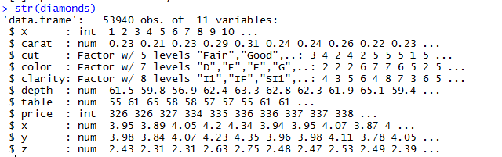
Discovery Cont.
Details of Data

Slide 5
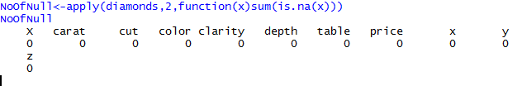
Data Prep
Data Prep
Get Dataset to Apply Visualization and Analytics Methods on it.
Detect Missing Values.

Slide 6
Model Planning
Visualize to understand the data.
Calculate Correlation to detect the important attributes affect the price.

Slide 7
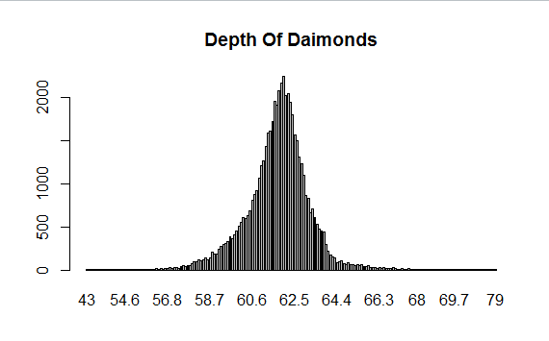
Visualization of Data
Most diamonds have a depth between 60 mm and 65 mm.

Slide 8
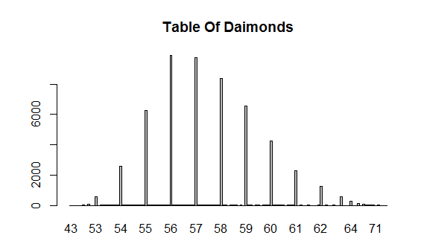
Visualization Cont.
Most diamonds have a table between 55 mm and 60 mm..

Slide 9
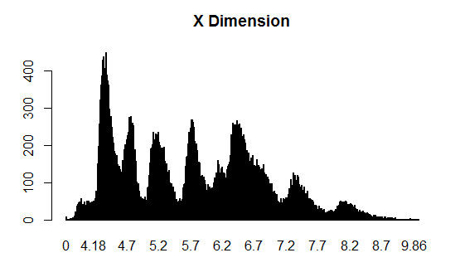
Visualization Cont.
Most diamonds have an x dimension between 4 mm and 7 mm.

Slide 10
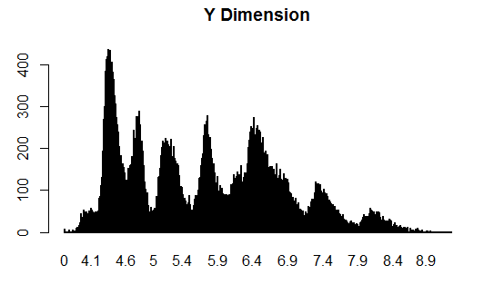
Visualization Cont.
Most diamonds have an y dimension between 4 mm and 7 mm.

Slide 11
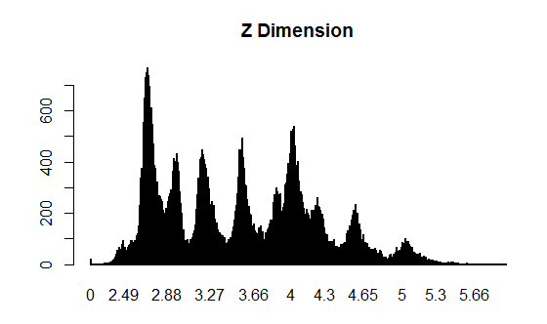
Visualization Cont.
Most diamonds have an z dimension between 2 mm and 4.6 mm.

Slide 12
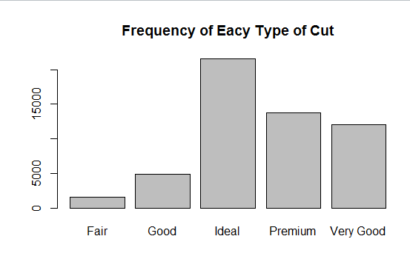
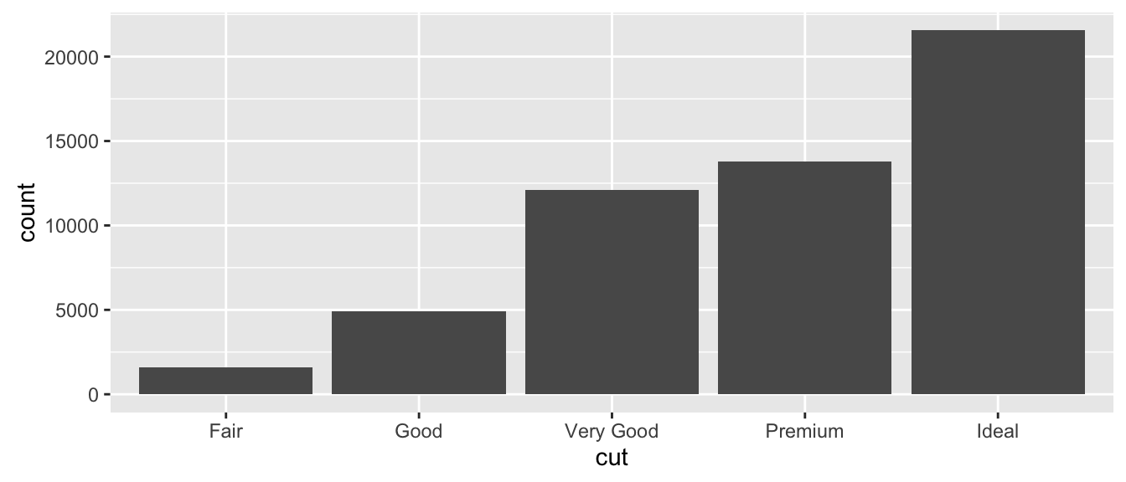
Visualization Cont.
Most diamonds are of ideal cut.

Slide 13
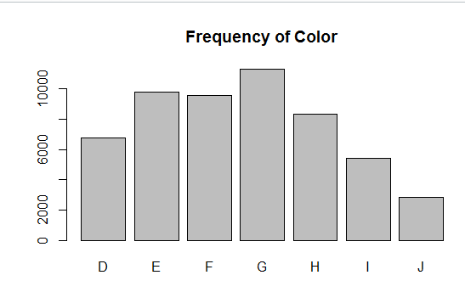
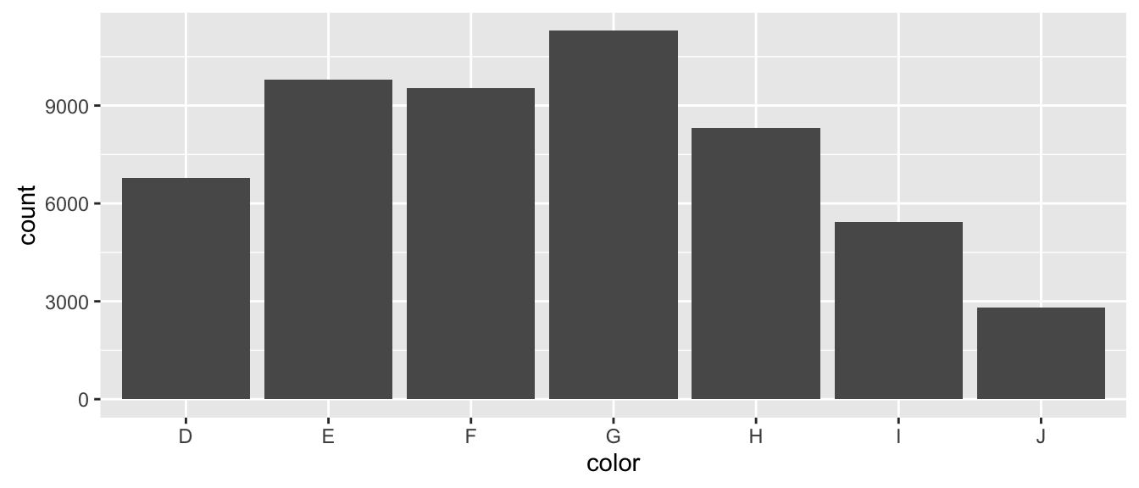
Visualization Cont.
Most diamond are G Color.

Slide 14
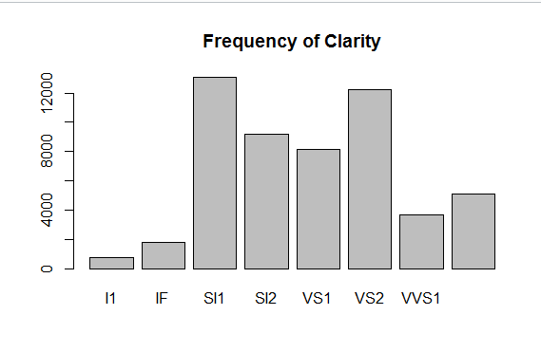
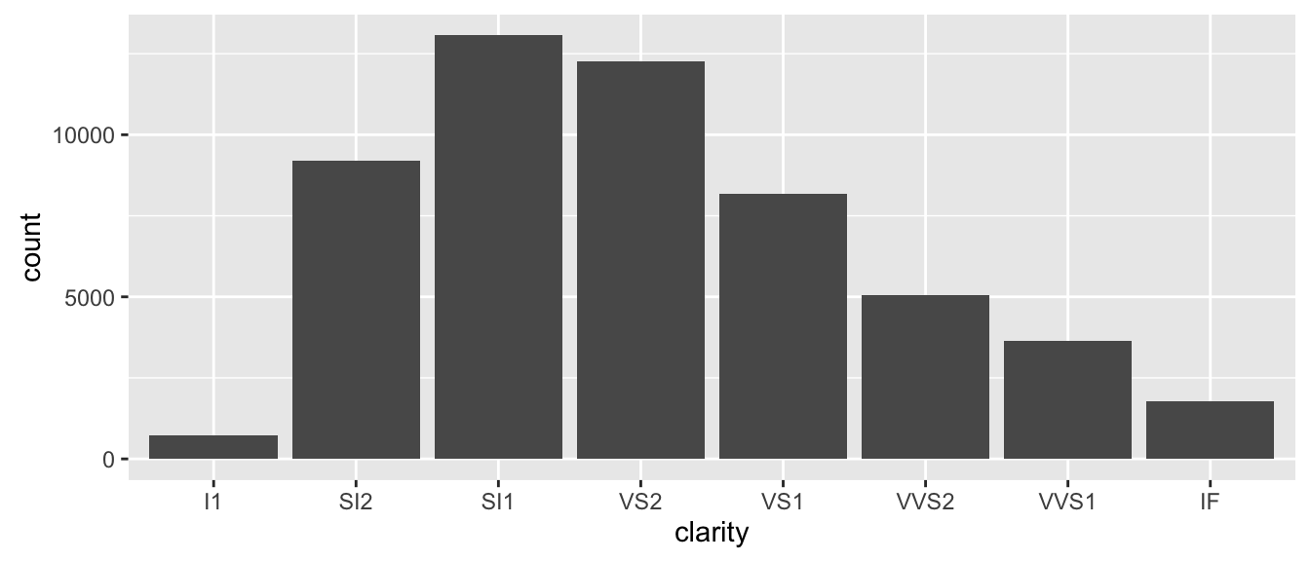
Visualization Cont.
Clarity is skewed to the right, most Diamonds is SI1 in Clarity.

Slide 15

Visualization Cont.
Min Carat is: .2
Max:5.01

Slide 16
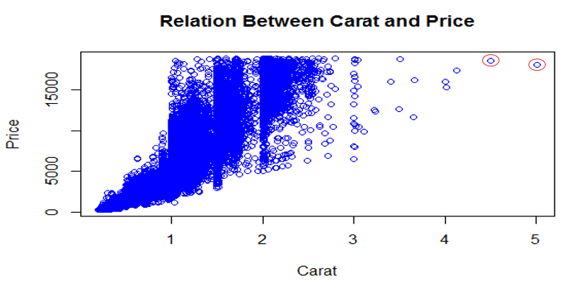
Visualization Cont.
Not Carat The Only Factor on Price as it shown in Figure.

Slide 17
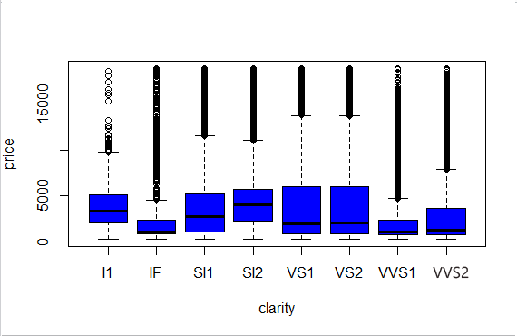
Visualization Cont.
VS1,VS2 have highest prices, although IF is the best.

Slide 18
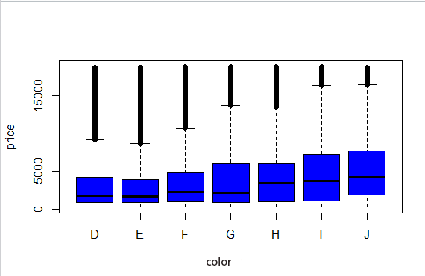
Visualization Cont.
Color J is the Highest in Price, although D is the best.

Slide 19
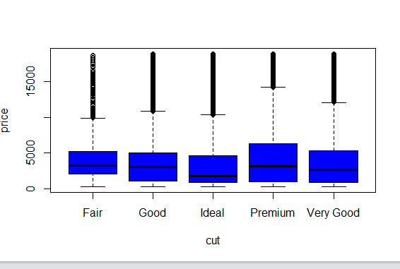
Visualization Cont.
Premium Cut is Highest in Price although Ideal is better in quality.

Slide 20
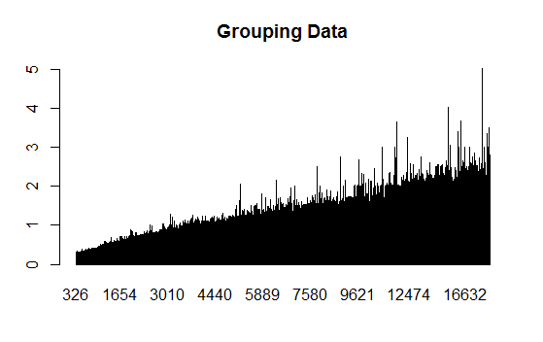
Visualization Cont.
Group diamonds carats based on prices.

Slide 21
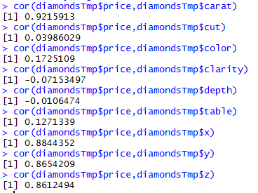
Model Planning
Calculate Correlation with price and each Column.

Slide 22
Model Building
Develop dataset of Training and Testing with Ratio 80% to 20%.

Slide 23
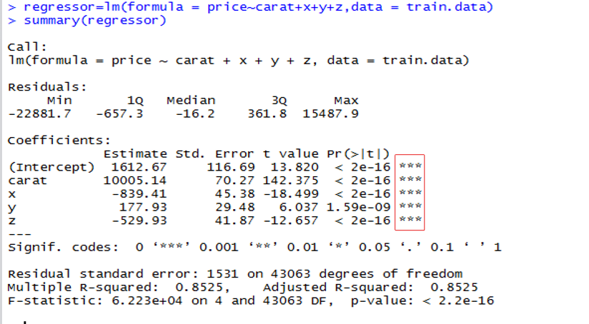
Model Building Cont.
From Correlation that calculated in model planning.

Slide 24
Model Building
To predict new price based on carat, x, y and z just apply this equation.
Price=A0+A1*Carat+A2*x+A3*y+A4*z

Slide 25
Communicate Result
Test The Accuracy of Model.
Did We Succeed? Did We Fail?

